Slide 1
EMPIRE BOOKSTORE INFORMATION SYSTEM
بِسْمِ اللَّهِ الرَّحْمَنِ الرَّحِيم
Here is where your presentation begins.

Slide 2




GROUP MEMBERS
01
03
NURALYA SAKINAH BINTI ADNAH
SARRAH SABIHAH BINTI BERHANUDDIN
02
04
SARAH HANA BINTI MOHAMADNADZIM
SITI MARSYA MAISARAH BINTI ROSLI
STUDENT ID: 2020617992
STUDENT ID: 2020834208
STUDENT ID: 2020828354
STUDENT ID: 2020479784

Slide 3
TABLE OF CONTENTS
01
04
Company Background
Tables | Data Dictionary | Data Definition Language
02
05
Problem Statement & Objectives
Application in Database System
03
06
ERD | 3NF Relational | Relationship
Examples of SQL Queries.
A little bit info about The Empire Bookstore Company.
Brief about primary key, foreign key, data type for all entities etc.
Brief a little about the problem occur and what are the aims.
Brief the application occur for the company database system.
Brief about ERD, 3NF and Relationship.
Brief on how to solve the queries and the output.

Slide 4

COMPANY BACKGROUND
Founded in 2015 by Farah Natasha and Nilofa Emer Khan.
Has 3 walk-in stores, each located in Shah Alam, Seremban and Kuala Lumpur.
The company’s sales have been drastically increased and the company cannot key-in the data manually.
This system help the worker and customer to purchase the book based on online order because of the long time period RMO
The client could access and key-in the data by the given entities: Book Order, Sales Details, Sales Order and Customer.

Slide 5
PROBLEM STATEMENT & OBJECTIVES
MISCALCULATION IN SALES OCCUR
DIFFICULT TO KEEP IN TRACK THE AVAILABLE BOOK
DIFFICULT FOR MANAGEMENT TO FUNCTION PROPERLY.
Can execute calculation of the book correctly.
Can easy access to check the availability of the book.
Can make system systematic.

Slide 6
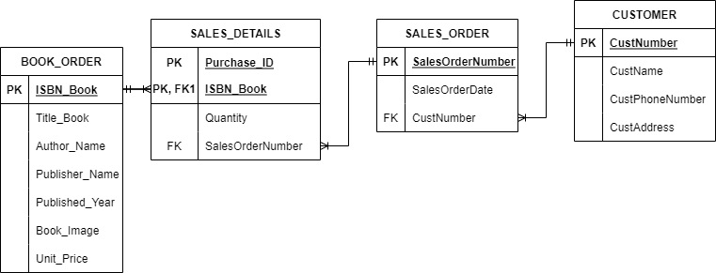
ENTITY RELATIONAL DIAGRAM
!RULES!
Each customer can make many order. Each order is made only by a single customer.
Each order contained many sales details. Each sales details occupied by only one order
Each book generates many sales details. Each sales details occupied by only one book.

Slide 7
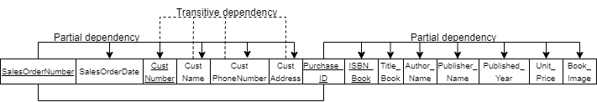
NORMALIZATION
FIRST NORMAL FORM (1NF)
(SalesOrderNumber, SalesOrderDate, CustNumber, CustName, CustPhoneNumber, CustAddress, Purchase_ID, ISBN_Book, Title_Book, Author_Name, Pubisher_Name, Published_Year, Unit_Price, Book_Image)
Parrtial Dependency:
SalesOrderNumber SalesOrderDate, CustNumber, CustName, CustPhoneNumber, CustAddress
ISBN_Book Title_Book, Author_Name, Pubisher_Name, Published_Year, Unit_Price, Book_Image
Transitive Dependency:
CustNumber CustName, CustPhoneNumber, CustAddress

Slide 8
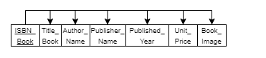
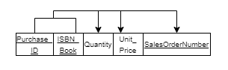
NORMALIZATION
SECOND NORMAL FORM(2NF)
Table: BOOK_ORDER
BOOK_ORDER (ISBN_Book, Author_Book, Title_Book, Publisher_Name, Published_Year, Unit_Price, Book_Image)
Table: SALES_DETAILS
SALES_DETAILS (Purchase_ID, ISBN_Book, Quantity, UnitPrice, SalesOrderNumber)

Slide 9
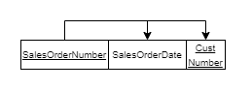
NORMALIZATION
Table: SALES_ORDER
SALES_ORDER (SalesOrderNumber, SalesOrderDate, CustNumber)

Slide 10
NORMALIZATION
THIRD NORMAL FORM(3NF)
Table: BOOK_ORDER
BOOK_ORDER (ISBN_Book, Author_Book, Title_Book, Publisher_Name, Published_Year, Unit_Price, Book_Image)
Table: SALES_DETAILS
SALES_DETAILS (Purchase_ID, ISBN_Book, Quantity, UnitPrice, SalesOrderNumber)

Slide 11
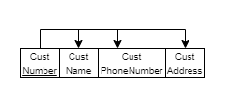
NORMALIZATION
Table: SALES_ORDER
SALES_ORDER (SalesOrderNumber, SalesOrderDate,
CustNumber)
Table: CUSTOMER
CUSTOMER (CustNumber, CustName, CustPhoneNumber, CustAddress)

Slide 12
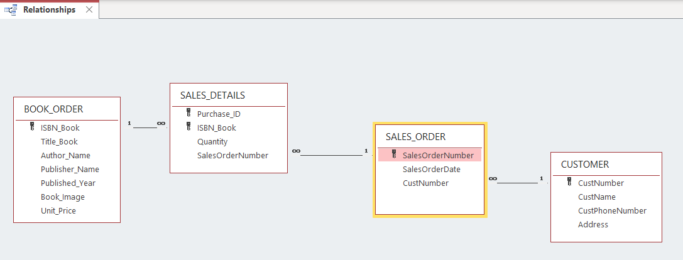
RELATIONSHIP

Slide 13
TABLES WITH DATA INTEGRITY
ENTITY | PRIMARY KEY | FOREIGN KEY
SALES_ORDER | SalesOrderNumber | CustNumber
SALES_DETAILS | Purchase_ID | ISBN_Book
BOOK_ORDER | ISBN_Book | -
CUSTOMER | CustNumber | -

Slide 14
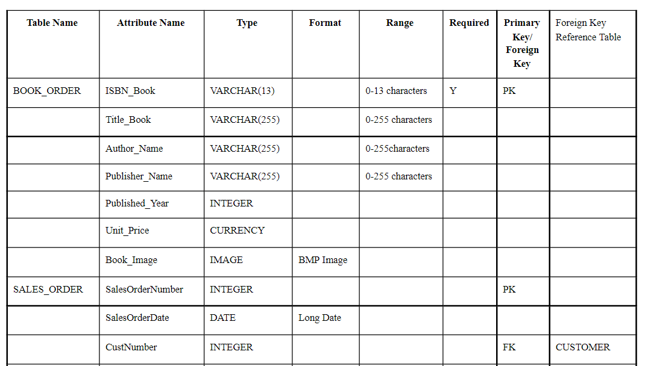
DATA DICTIONARY

Slide 15
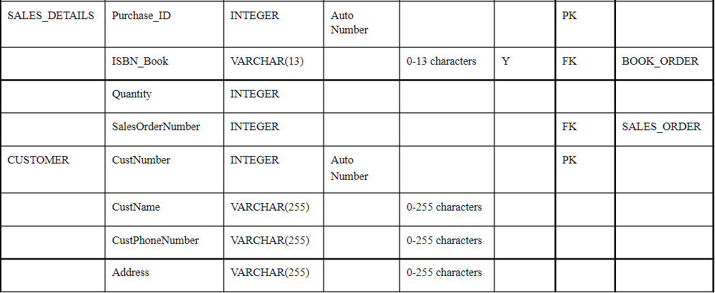
DATA DICTIONARY

Slide 16
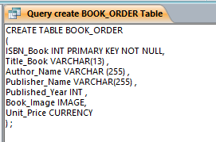
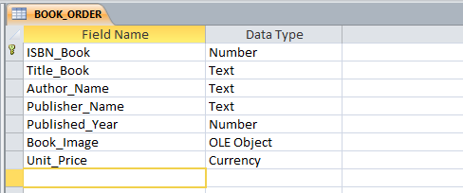
DATA DEFINITION LANGUAGE
TABLE: BOOK_ORDER
OUTPUT:

Slide 17
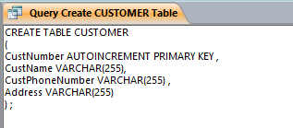
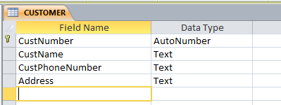
DATA DEFINITION LANGUAGE
TABLE: CUSTOMER
OUTPUT:

Slide 18
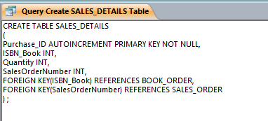
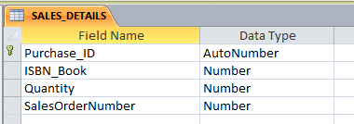
DATA DEFINITION LANGUAGE
TABLE: SALES_DETAILS
OUTPUT:

Slide 19
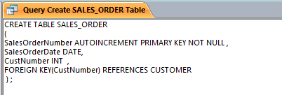
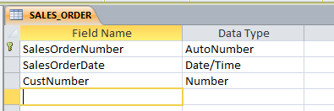
DATA DEFINITION LANGUAGE
TABLE: SALES_ORDER
OUTPUT:

Slide 20
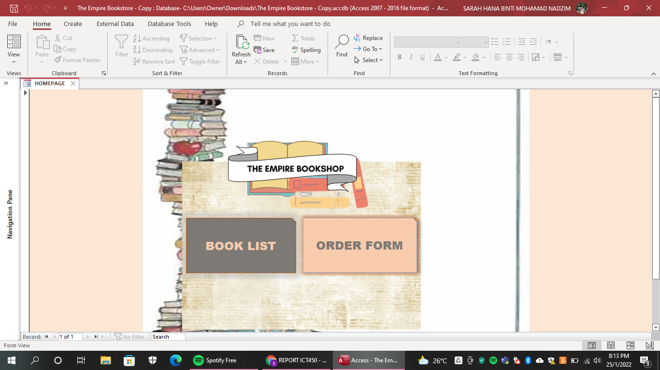
APPLICATION SCREENSHOT
HOMEPAGE

Slide 21

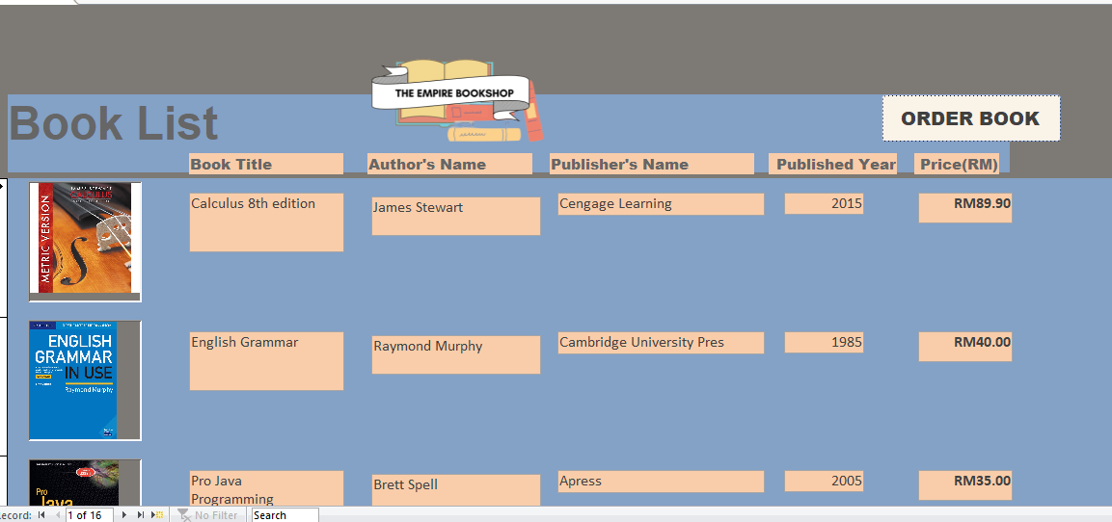

BOOK LIST

Slide 22

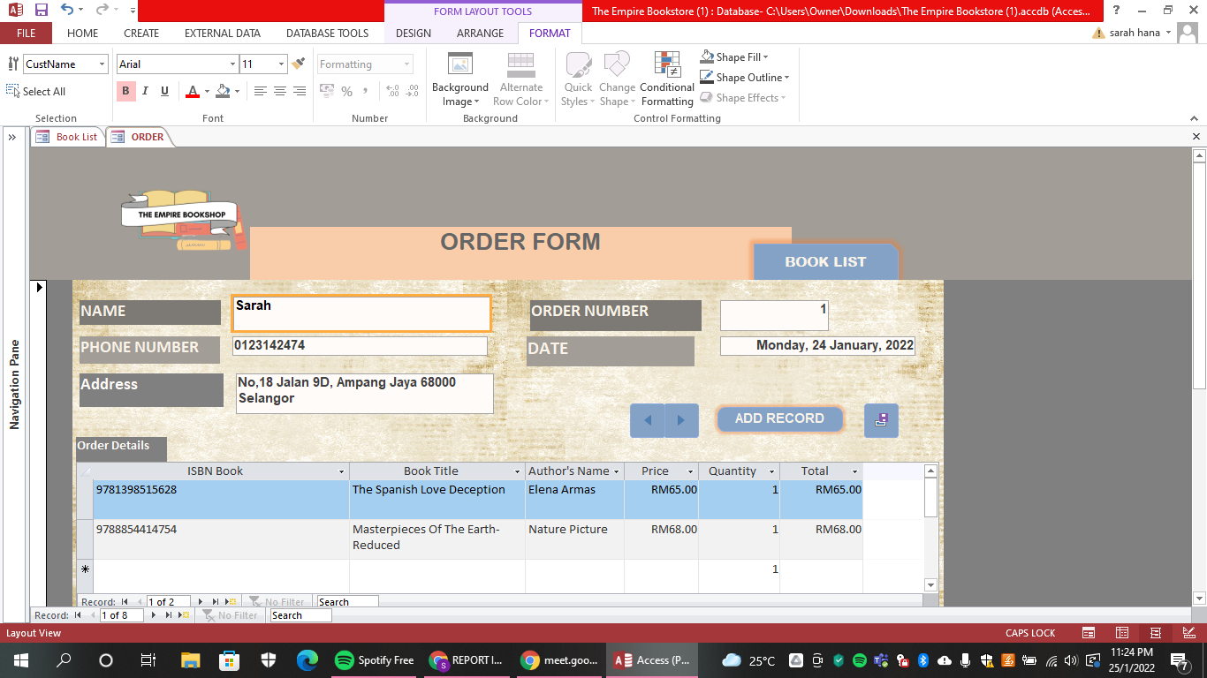
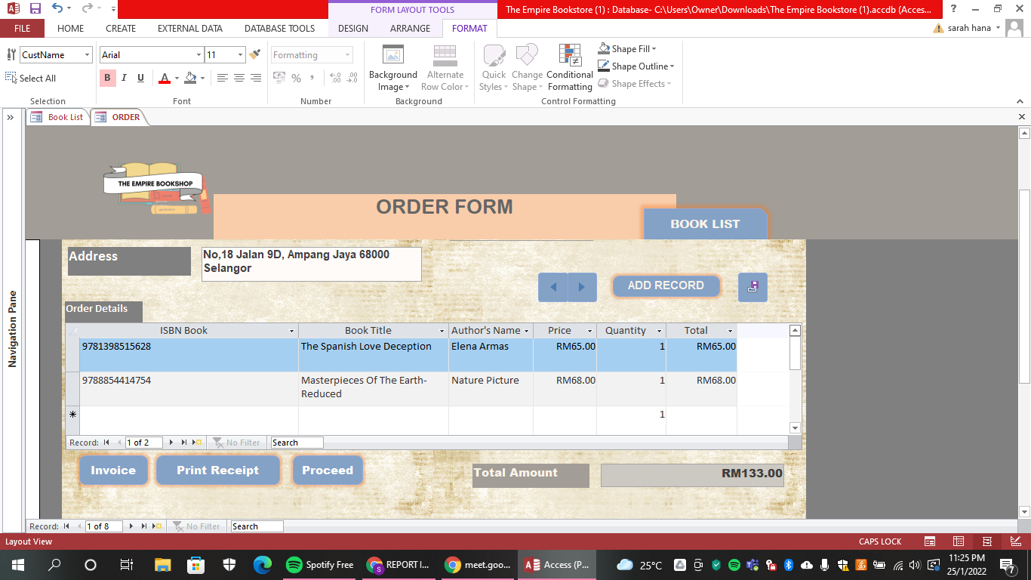
ORDER FORM

Slide 23

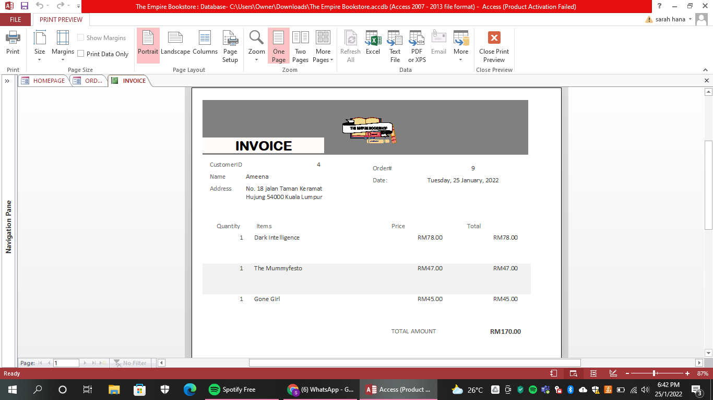
INVOICE

Slide 24
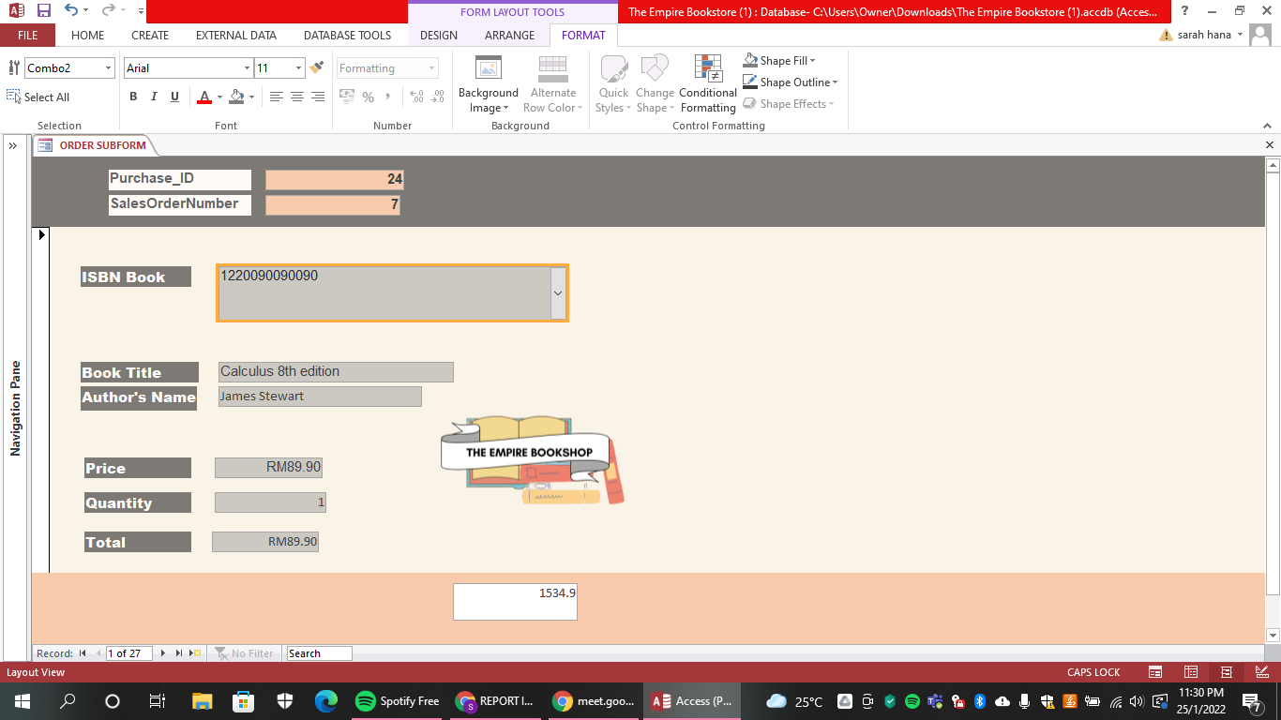
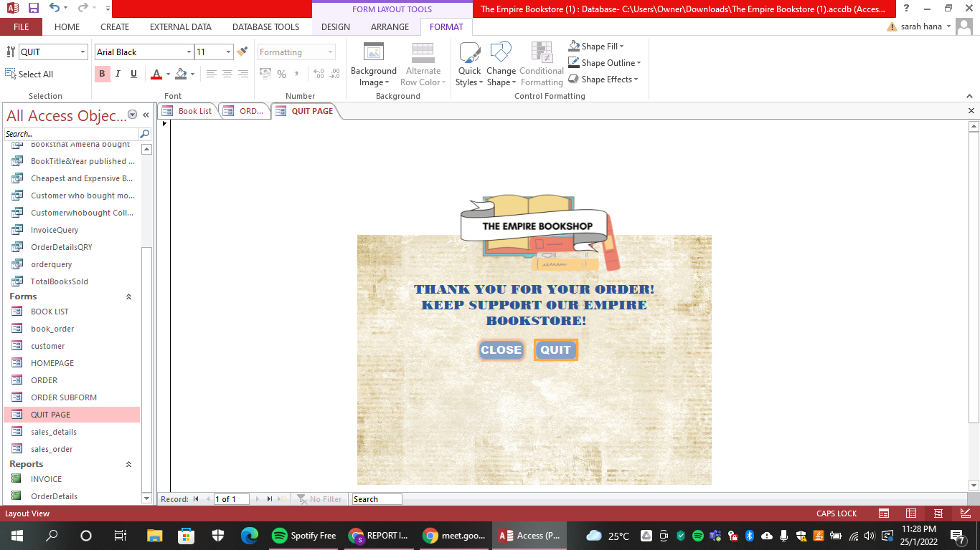
QUIT PAGE
ORDER SUBFORM

Slide 25

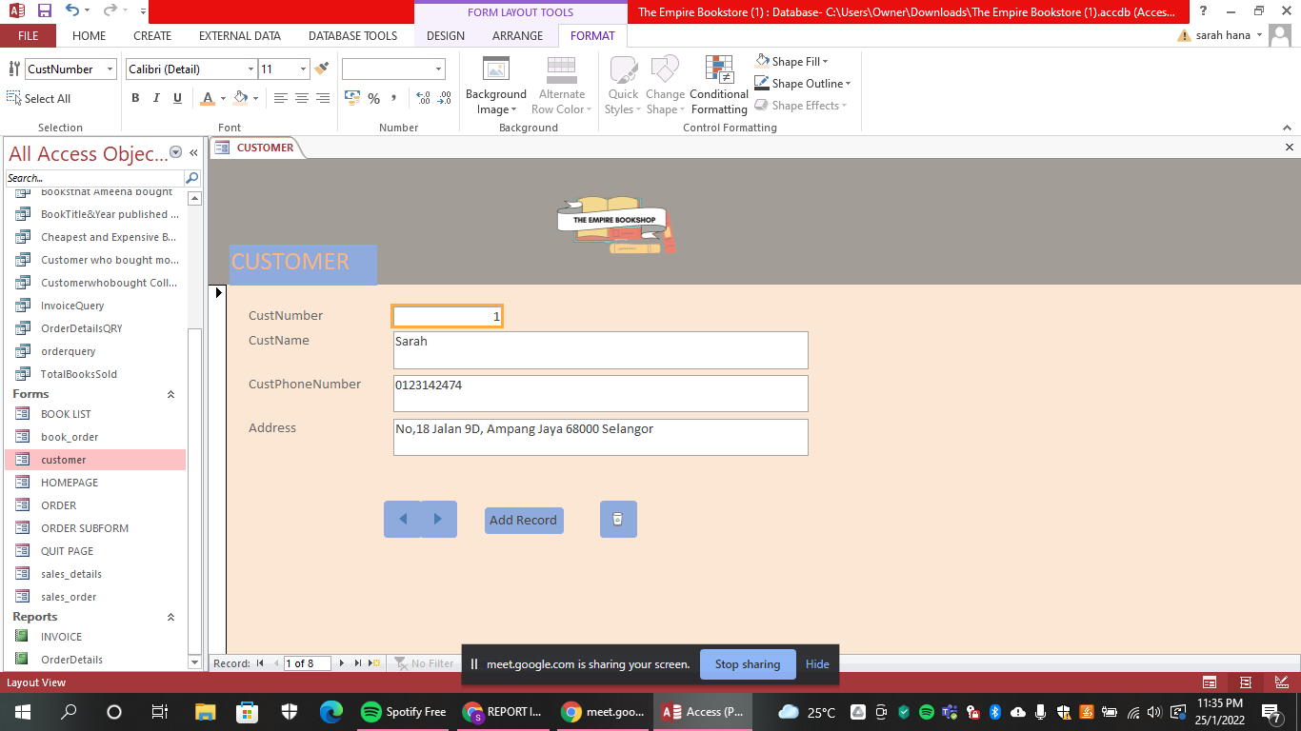
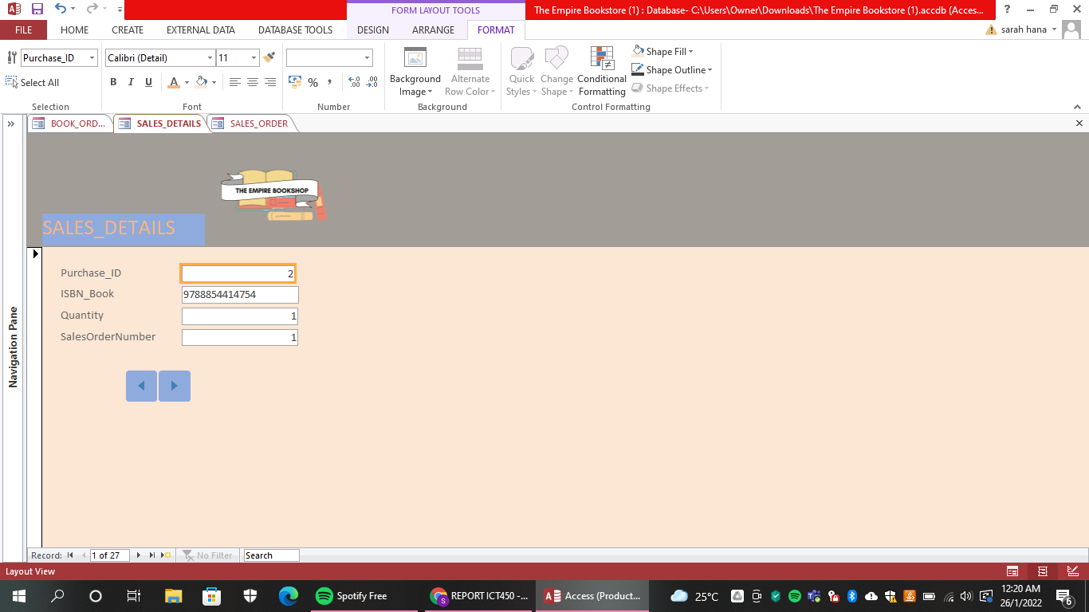


CUSTOMER FORM
SALES DETAILS FORM

Slide 26
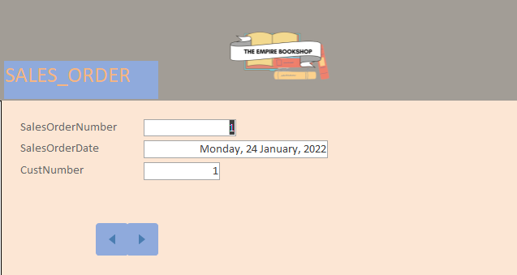
SALES ORDER FORM

Slide 27
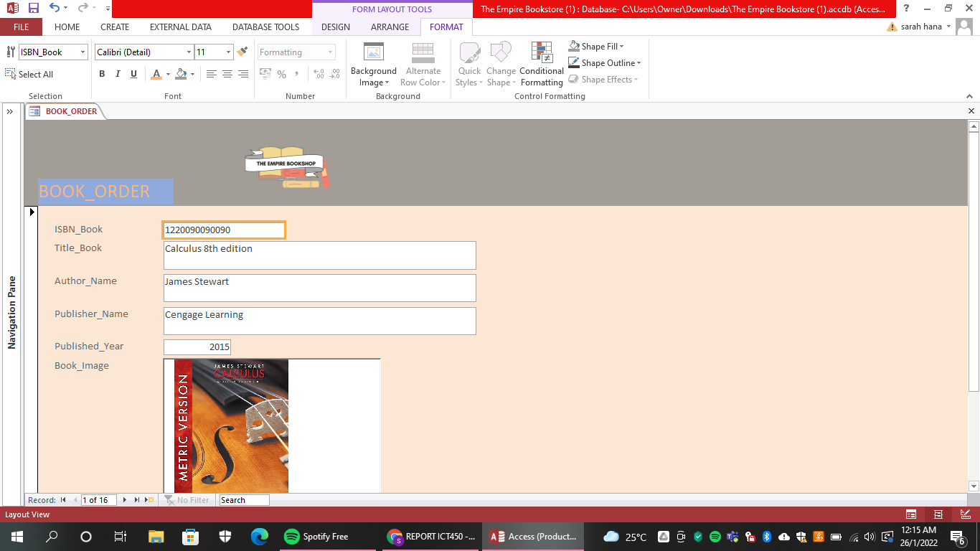
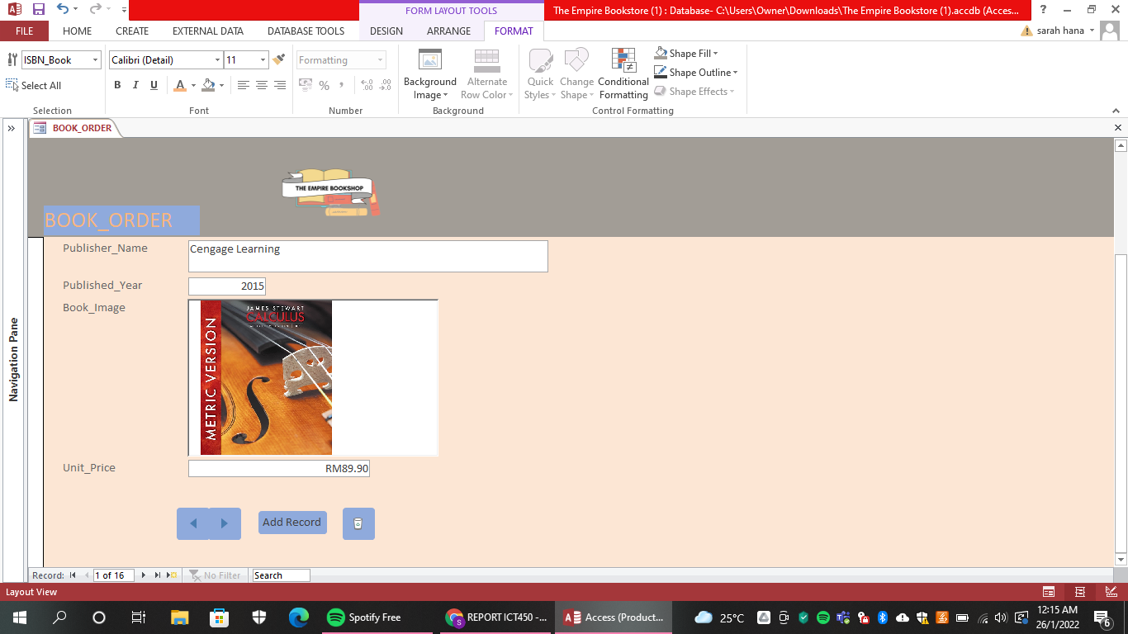
BOOK LIST FORM

Slide 28


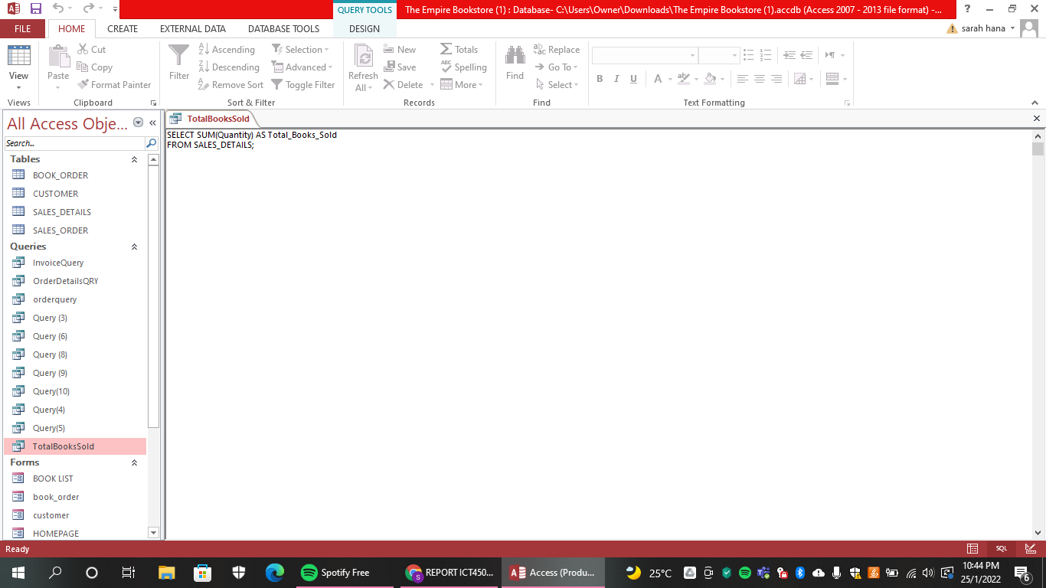
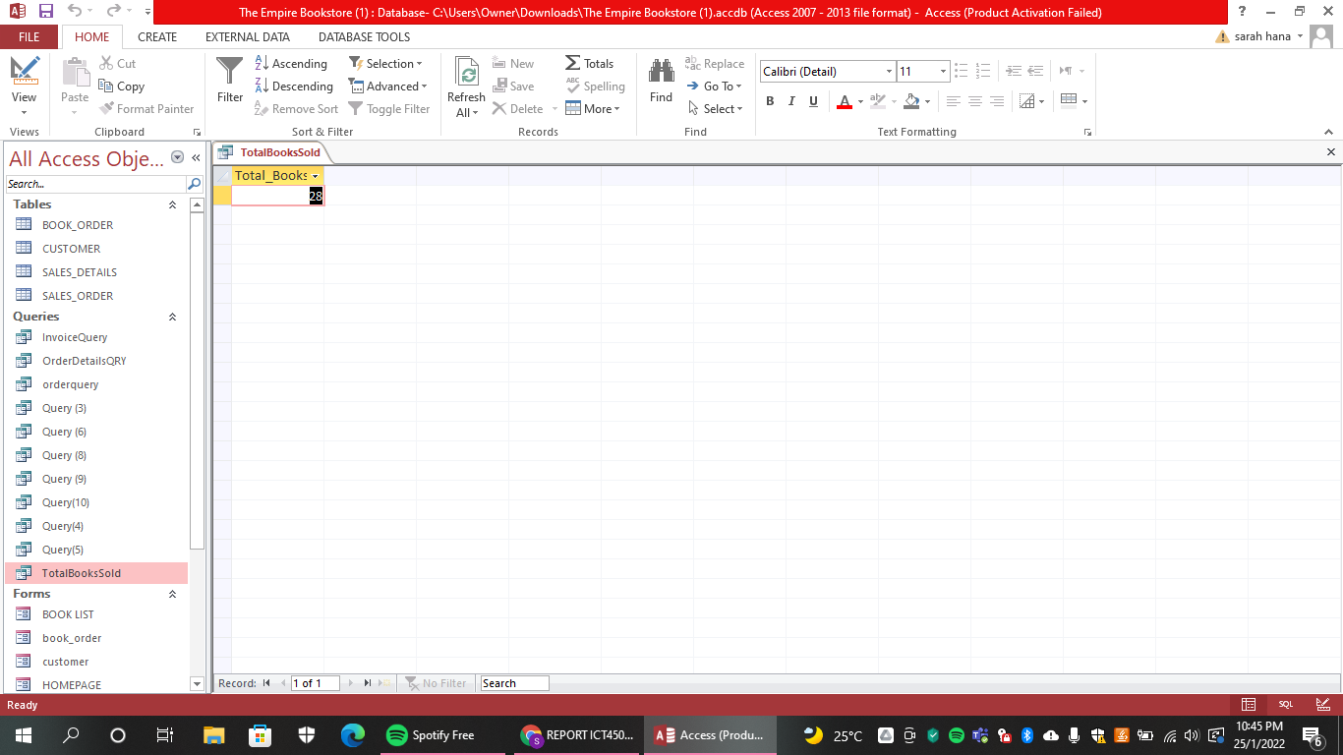
SQL QUERIES
1) Retrieve the total quantity of books sold by Empire Bookstore.
Output

Slide 29


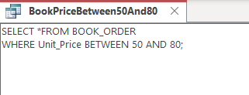
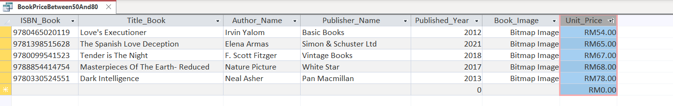
2) Retrieve all books with a price between RM50 and RM80.
Output

Slide 30

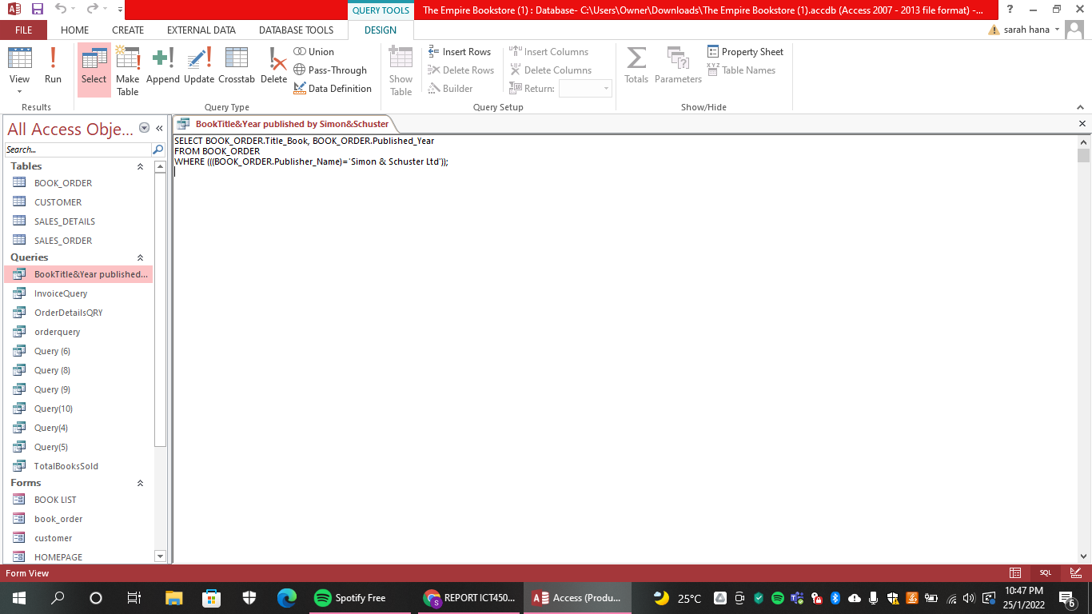

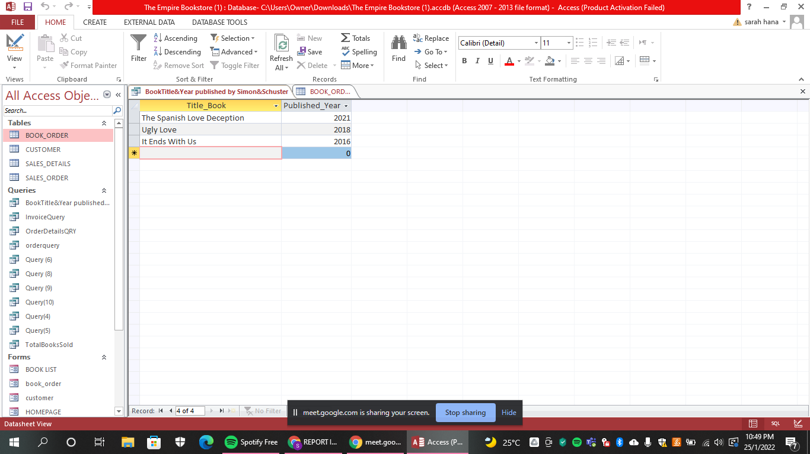
3) Retrieve the title of book and year published by Simon & Schuster Ltd.
Output

Slide 31

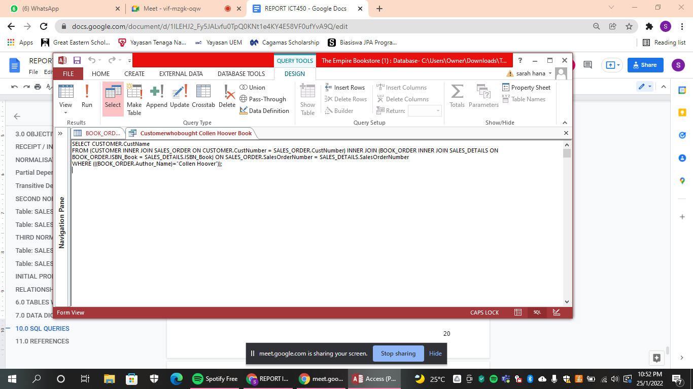
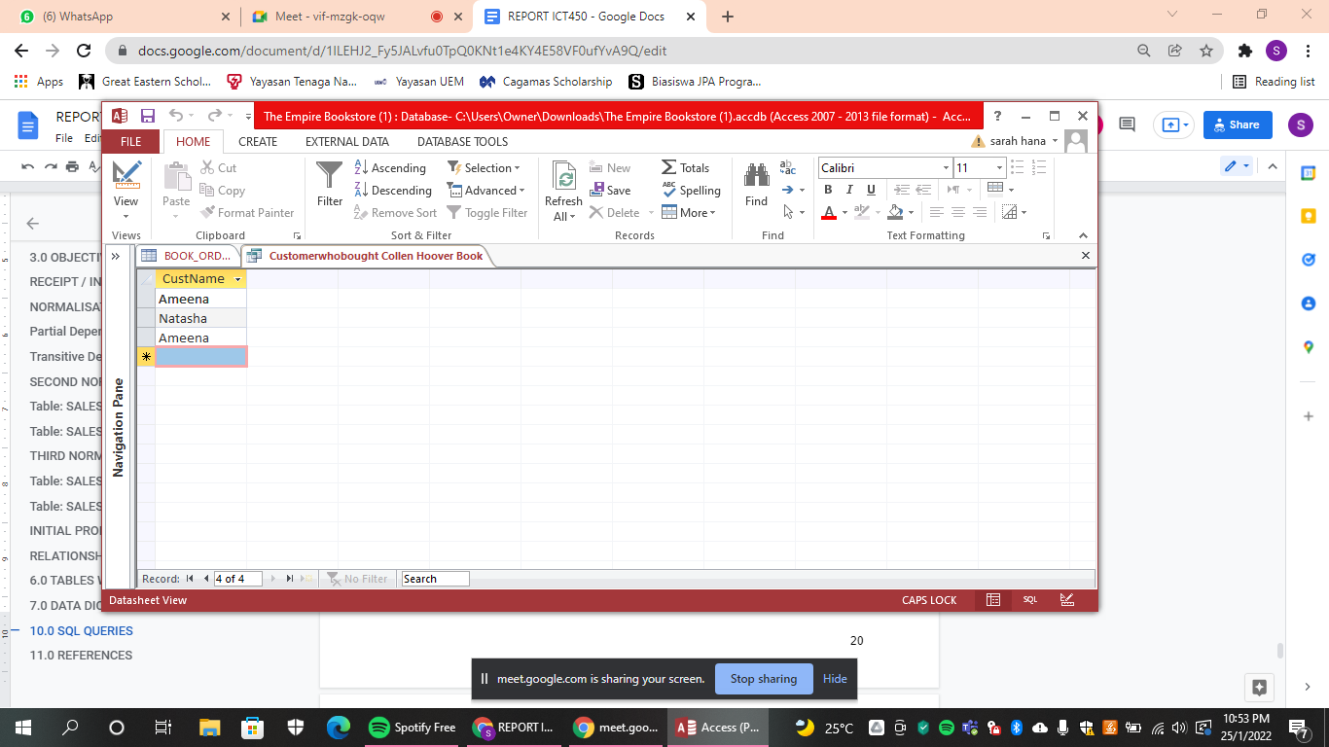
4) Retrieve the name of the customer who bought the book written by Colleen Hoover.
Output

Slide 32

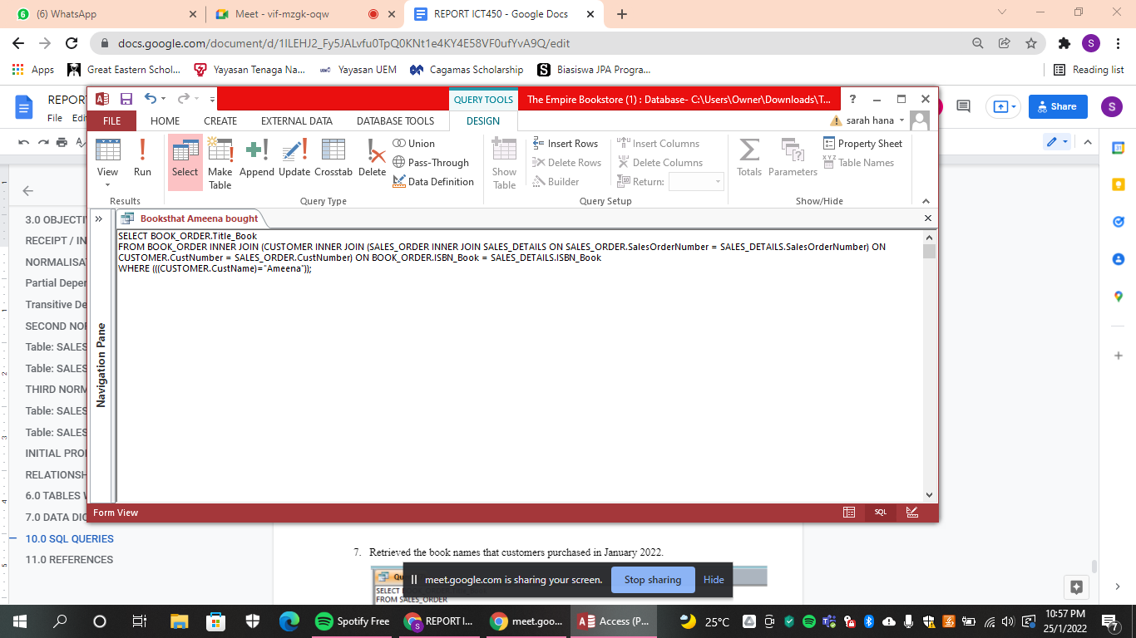

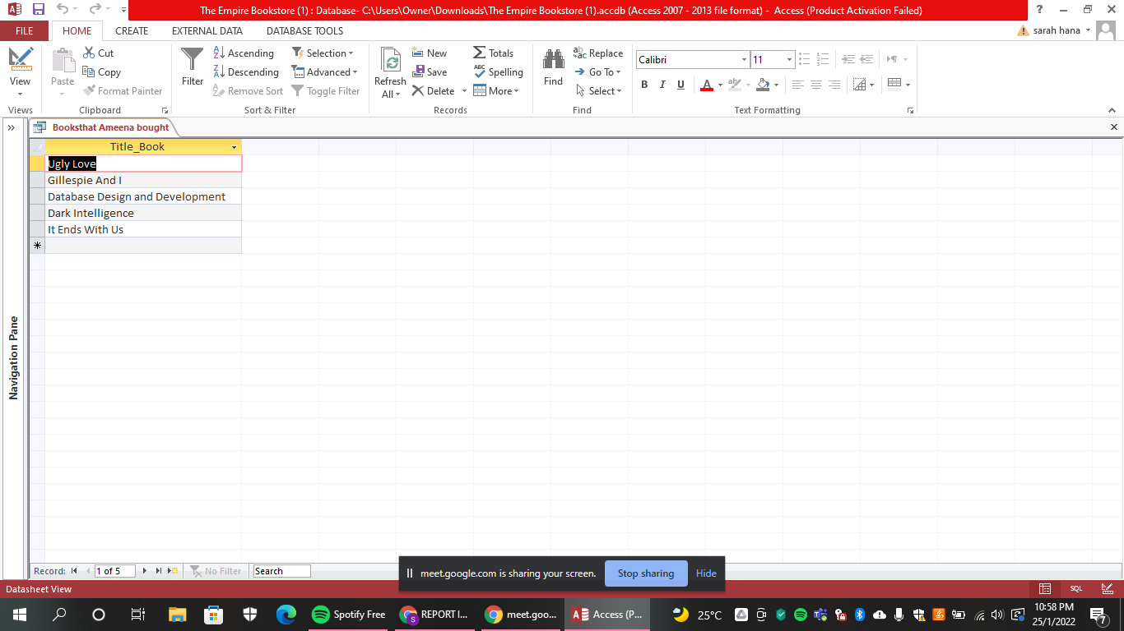
5) Retrieve the book title that Ameena bought.
Output

Slide 33
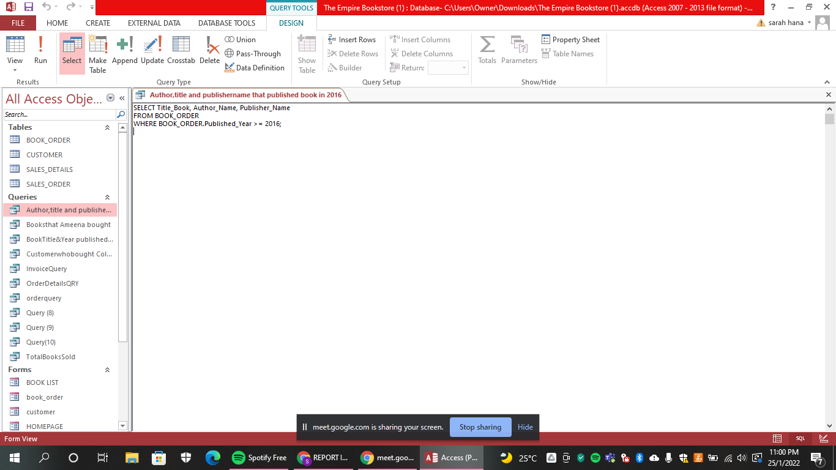

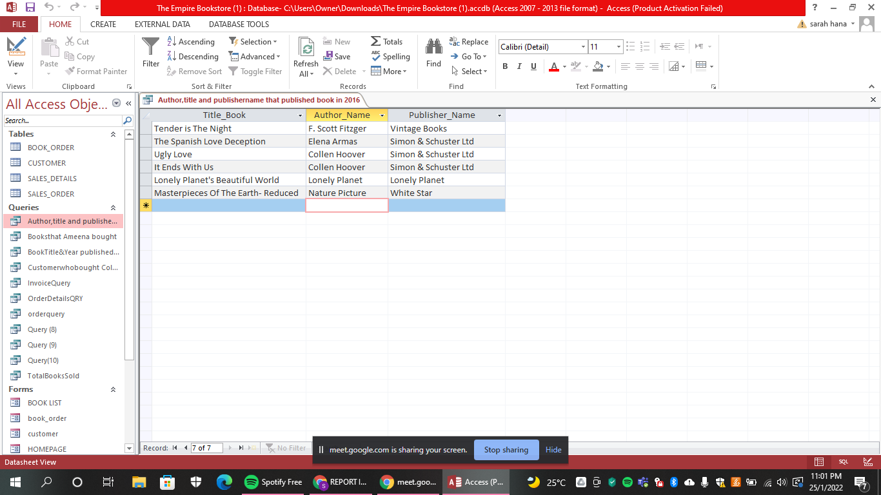
6) Retrieve the title of the book, author name and publisher name which has at least published the book in 2016.
Output

Slide 34
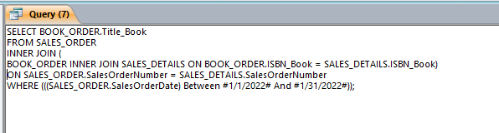
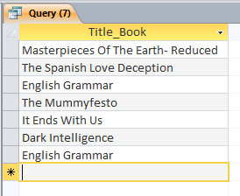
7) Retrieved the book names that customers purchased in January 2022.
Output

Slide 35
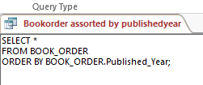
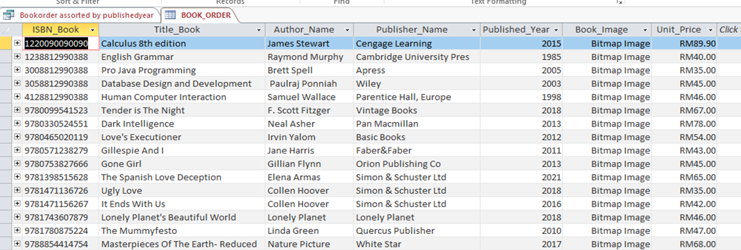
8) Selects all books from the “Book_Order” table, sorted by the “Published_Year” column.
Before

Slide 36

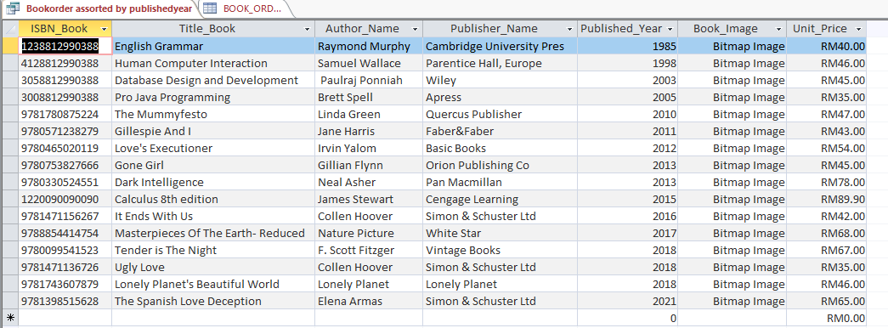
After

Slide 37
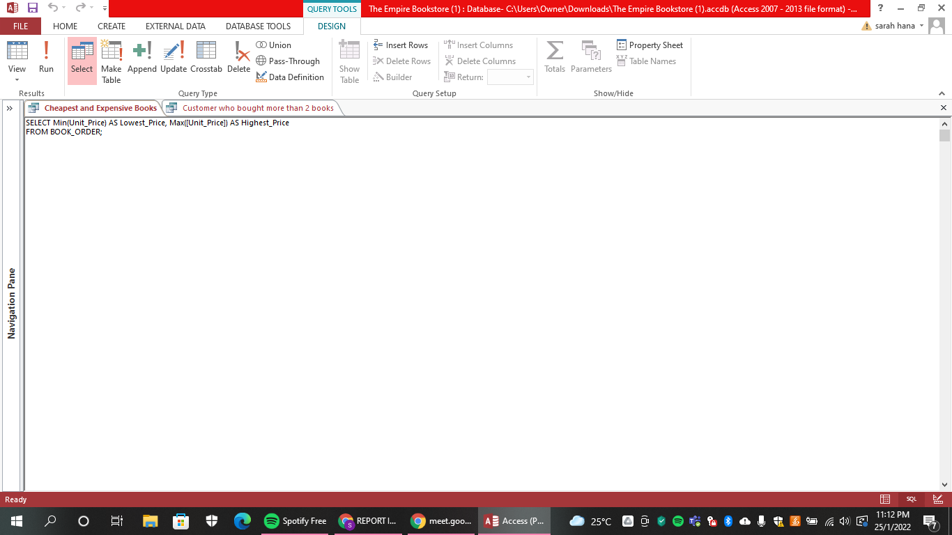


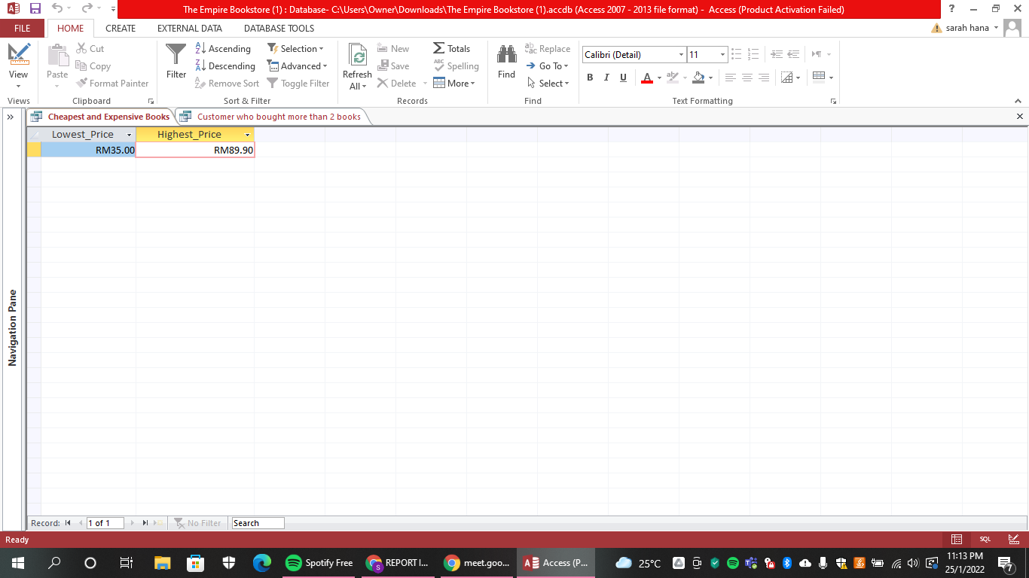
9) Retrieve the price of the cheapest and expensive book.
Output

Slide 38
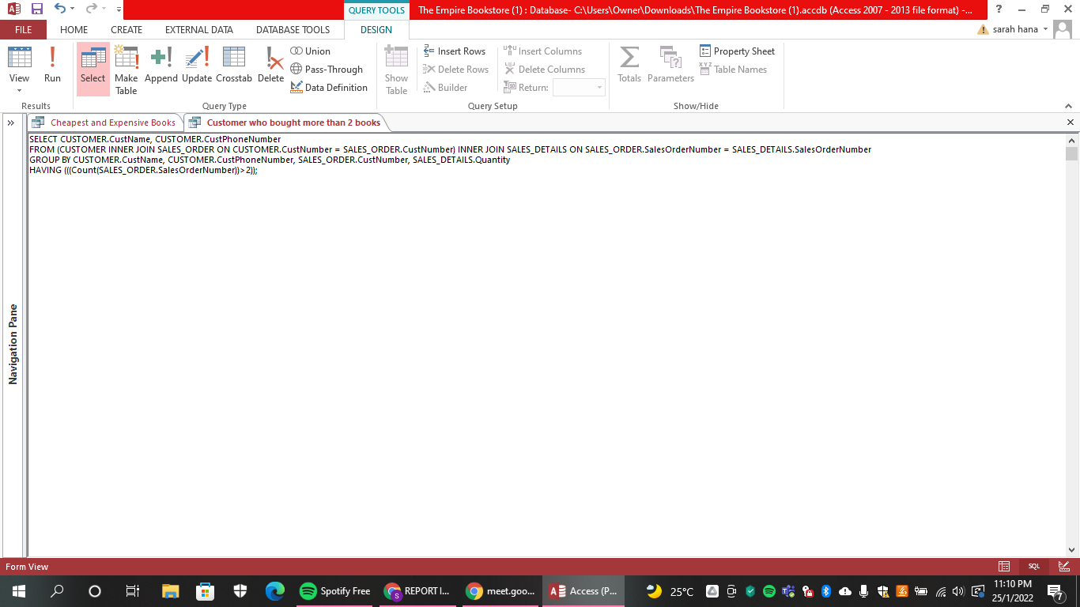
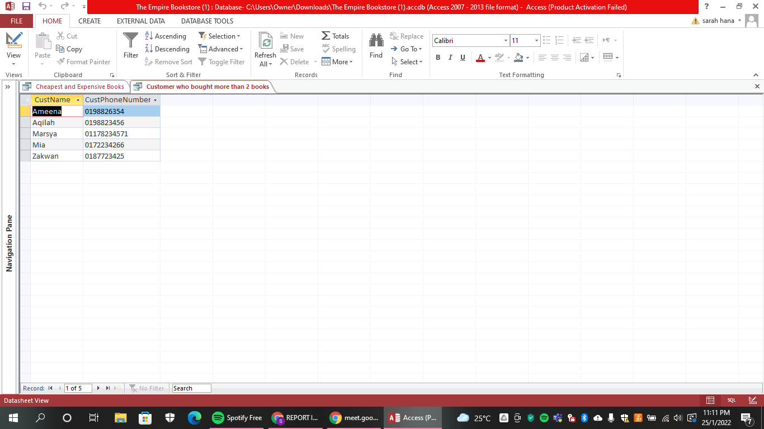
10) Retrieved the name and phone number of a customer who bought more than 2 books.
Output

Slide 39
THANK YOU!
Does anyone have any question?
addyouremail@freepik.com

